Slide 1
Business Processes Mapping
Lecture – 02

Slide 2

Lecture 02 - Recap
How organizations use IS Today – Strategic business objectives
Operational excellence
New products, services, and business models
Customer and supplier intimacy
Improved decision making
Competitive advantage
Survival

Slide 3
Learning Outcomes
LO2: Evaluate the information systems strategies to achieve organizational goals

Slide 4
Session Outcome
After completing this session you will be able to;
Develop complete consistent process maps
Effectively analyze flow charts to identify improvement opportunities.

Slide 5
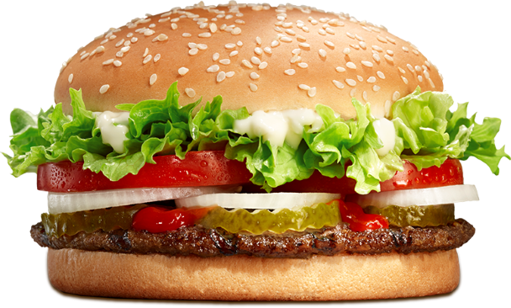
What is a Business Process?
A business process is a collection of interrelated activities that takes one or more kind of inputs and creates an output that is of value to the customer.
Lets walk to McDonald’s. Your favorite fast food restaurant.
What kind of business processes you can find there?
Example: Preparing a Burger Meal
Activities
Take order, prepare meal, deliver meal
Inputs
Burger bun, meat, tomatoes, potatoes, labor, etc.
Output
Hamburger

Slide 6
Why Process Mapping?
Because…
These questions require a good, documented and communicated understanding of business processes!
How do the processes look like?
How do we know that we manage our processes well?
How can we train staff in our processes?
How can we ensure required process compliance?
How can we design and use IT to support our processes?
How can we organize and conduct process improvement?

Slide 7
Process mapping?
Break down the process in to activities/steps and visualize it pictorially to highlight the flow of performing them.

Slide 8
Process mapping - Characteristics
A visual representation of a flow of a process for a product or service.
Within specified boundaries.
Uses symbols and arrows to display inputs, outputs, tasks performed and task sequences.
Helps to analyze the process.
Also referred to as Flow charts or Flow Diagrams.
First step in Process improvement effort.

Slide 9
Questions to understand the process flow
What is happening?
When is it happening?
Who is doing it?
Where is it happening?
How long does it take?
How is it being done?
Why is it being done?

Slide 10
Developing a Process Map

Slide 11
Process Mapping - Notations
Start or End point
A Manual operation depicted as a sub process
Totally automated activity depicted as a sub-process
Decision
Process flow direction

Slide 12
Process Mapping – Notations Cont.
Document
Database
Multidocument
Delay
Off-page connector
Another Process
Phase Separator

Slide 13
Example:
Start
Note:
use terminator/start symbol to show start and end of the process
Use off page reference to link to another process map page
Use delay symbol to show when delays occurs: waiting on queue’s, waiting for an event, etc.
Always try to identify timing for each activity + total phase time
Activity /
Sub process 1
A delay
Decision
Activity /
Sub process 3
No
Yes
Activity /
Sub process 2
End of the Process

Slide 14
Possible process map drawing
Page 1
Page 2
documents
A phase:
Time:
If
P3
Process
Starting
P1
P2
1
1
Ending
Activity
Yes
documents
No
document
File-away
P3
Different
process

Slide 15
Example: Travelling process
Leave from home
Get a ticket
Bus ticket
Walk towards
the bus halt
Wait until bus reach to the destination halt
Waiting for a bus
Ring the bell
A bus reached to the bus halt?
No
Get down the bus
Yes
Get in to the bus
Walk to the Destination
Reach to the destination

Slide 16
Class Activity – Draw a Process Map for the following process
Register for hostel accommodation
Go to hostel and Request a ‘Registration Request Form’ from hostel manager.
Hostel manager gives a RR form to student, and inform of last date and time to submit the form to hostel manager.
Student Fill in the registration request form.
Hand-over registration form and Student ID to hostel manager.
Hostel manager checks the RR form.
Hostel manager record the student registration in student registration book.
Hostel manger files the form in current registration request forms file.

Slide 17
Answer:
Issue a RR form
with deadlines
RR form
Student
Registration
Book
Receiving a Registration Request
Waiting for the form submission
Record Registration
Documents submitted by the student?
Files the RR Form
RR forms file
No
Yes
End of the Process
Filled RR form & Student ID
Checks RR form
Checks RR form

Slide 18
Analyzing a Process Map
[Purpose of analyzing is to improve the process]

Slide 19
Questions to improve the process:
What problems do you experience with the process?
Where can the process be improved?
Describe the ways in which other people do this process differently?
Does the process always work this way, are there exception?
What happens when things get really busy, do people do things differently?
What happens when people go on leave, is it a problem to get everything done?
What are all the documents that can be used in this process?
What reports does this process produce and how are they used?
At what stages are the documents handed over to others?

Slide 20
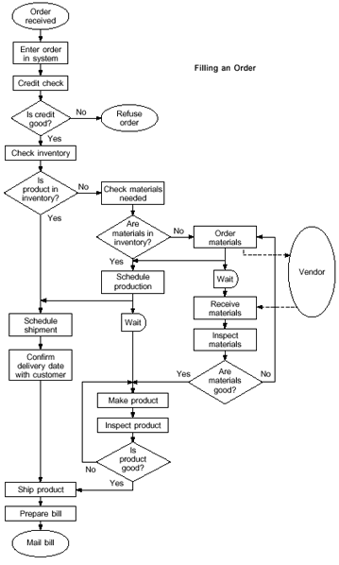
Class Activity : Analyze this process map and prepare a list of questions to ask in order to improve the process.

Slide 21

Benefits
Gives everyone a clear understanding
of the process
Identify different steps in the process with the right order.
Easy to learn and understand.
Helps to identify non-value-added operations.
Good communication language and supports team/group work.
Keeps everyone on the same page.

Slide 22

Next Lecture
Modern Information Systems in Business

Slide 23

End of Lecture 02

